Slide 1
CS151/EE M116C
Computer System Architecture
Policy and Syllabus
Fall 2017
Prof. Lei He

Slide 2
Course Structure
3 weeks on Instruction Set Arch and Arithmetic
Midterm I, tentatively Oct 25 (Wed) or 30 (Monday)
2 weeks on Data Path and Control Design
1 week on pipeline
Midterm II, tentatively Nov 13 (Mon) or 15 (Wed)
2 weeks on Memory (cache) and I/O
1 week on fast networks and multiprocessors
Final exam, Wednesday, Dec 13, 6:30pm - 9:30pm
Optional: new development such as GPU, TPU and FPGA accelerator for AI (if time allows)
Most students in previous years liked two midterm exams

Slide 3
Homeworks
Assigned every Wednesday
Due the following Monday before class
  No homework accepted after lecture starts
Solutions available Tuesday evening on Web
No credit for late homework
Only seven out of eight homeworks count!
  Lowest score is automatically discarded
  Or a student may skip one homework
Notes:
This is the 1st slide of the “Course Structure and Course Philosophy” section of the lecture.
Need to emphasis that for exams, our goal is the test your knowledge. It is not our goal to test how well your perform under time pressure.

Slide 4
Exams
Reduce the pressure of taking exams
  Midterm I: Instruction Set Arch + Arithmetic
  Midterm II: data path, control and pipeline
  2 hrs to take 1-hr test
  Final exam: entire book
  3 hrs to take 1.5-hr test
  Each exam allows a single-sided letter-size cheating sheet
  Sample exam with solution available online
Notes:
This is the 1st slide of the “Course Structure and Course Philosophy” section of the lecture.
Need to emphasis that for exams, our goal is the test your knowledge. It is not our goal to test how well your perform under time pressure.

Slide 5
Grading
Grade breakdown
  Midterm Exams: 30%
  Final exam: 47%
  Homework Assignments 21%
  End of quarter teaching evaluation 2%
Average grade will be a B or B+
  set expectations accordingly
Petitions can be filed before final exam to make it count for 61% by dropping score for one midterm
  Another midterm exam 15%

Slide 6
Course Problems
Can’t make midterm
  Tell us early and we will schedule alternate time
Forgot to turn in homework/ Dog ate computer
  One-time courtesy due to our grading policy
What is cheating?
  Studying together in groups is encouraged
  Work must be your own
  Common examples of cheating: running out of time on a assignment and then pick up output, take homework from box and copy, person asks to borrow solution “just to take a look”, copying an exam question, ...
Penalty for cheating:
  0 for homework assignment, i.e., 3% each time
  0 for exam

Slide 7
Course Administration
Instructor:
  Prof. Lei He (lhe@seas.ucla.edu)
  Office: Boelter Hall 6731D
  Office Hours: M 3-5
  Extra Office Hours: By email appointment
TA: Mr. Yuan Liang, liangyuandg@ucla.edu

Slide 8
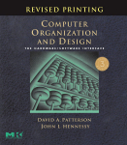
Textbook
Computer Organization and Design: The Hardware/Software Interface,
Patterson and Hennessy
  Patterson, PhD from UCLA Computer Science
  Hennessy, president of Stanford University

Slide 9
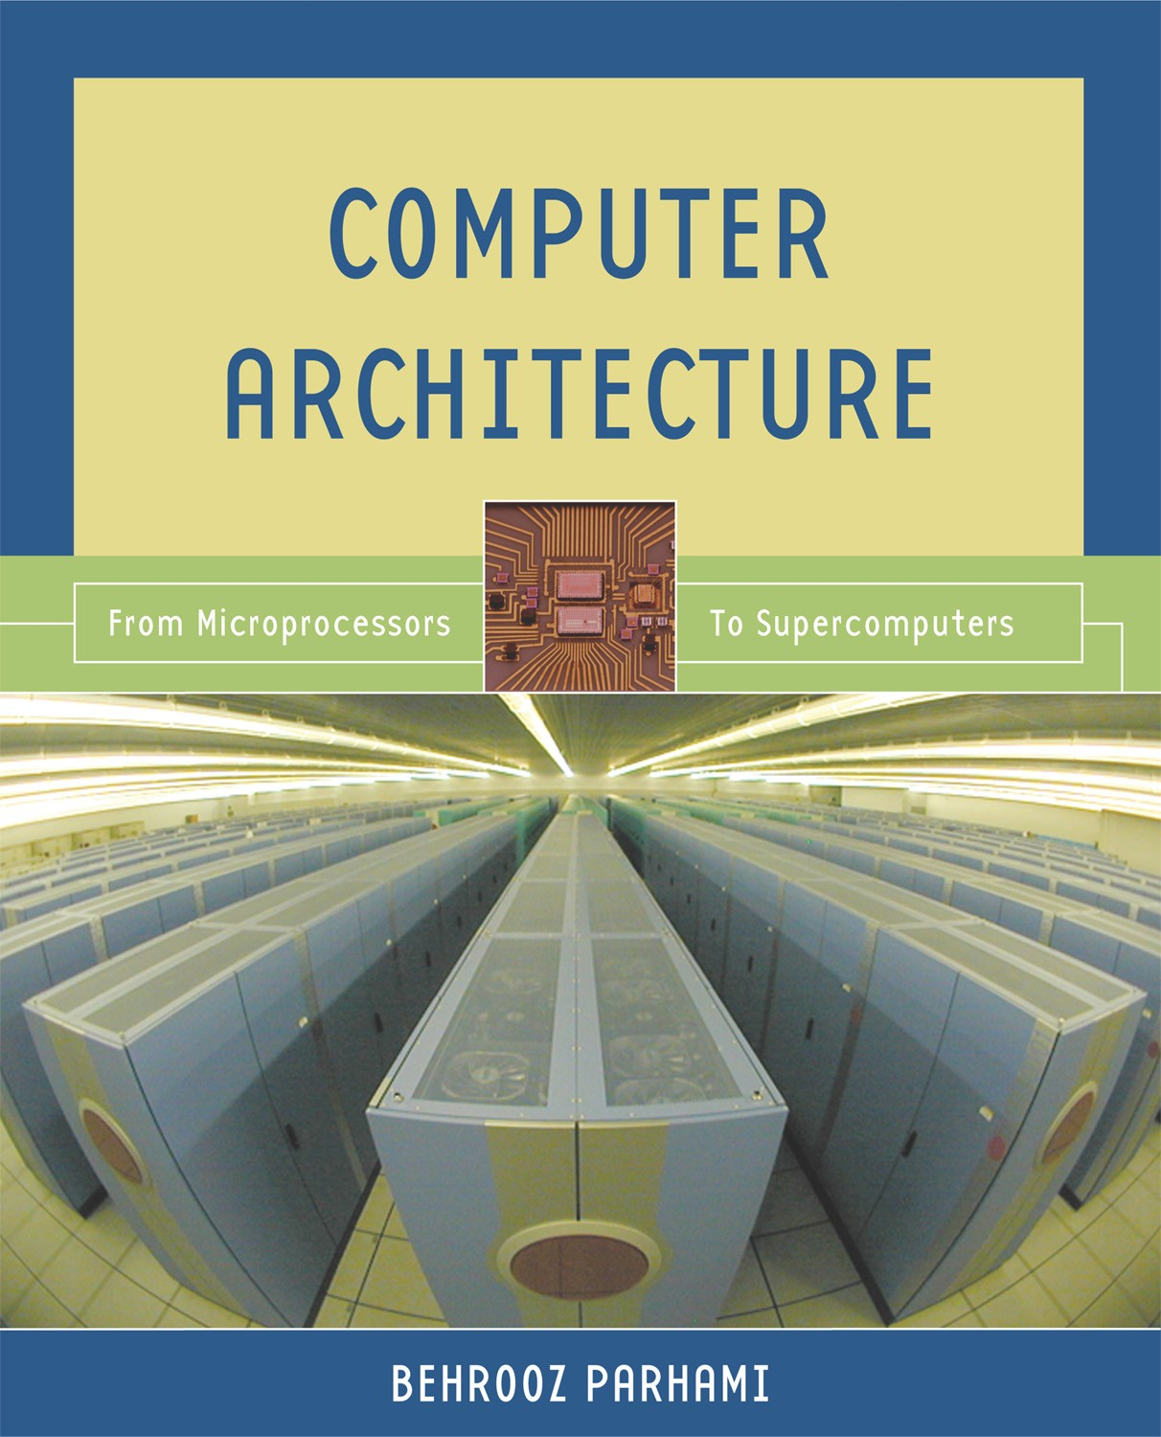
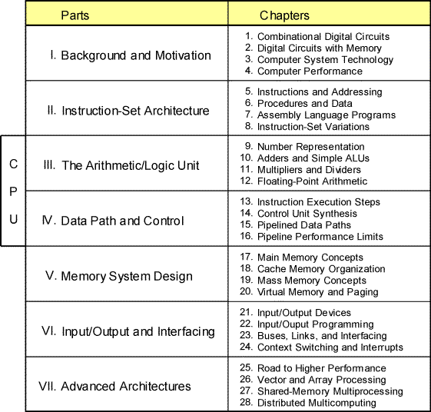
A Useful Reference
Some slides are taken from this book
http://www.ece.ucsb.edu/~parhami/text_comp_arch.htm#present

Slide 10
What you should know before taking EE116/CS151B
Basic machine structure
  processor, memory, I/O
Read and write basic C programs
Read and write in an assembly language
  MIPS preferred
Understand the steps in a make file and what they do
  compile, link, load & execute
Understand the concept of virtual memory
Logic design
  logical equations, schematic diagrams, FSMs, components

Slide 11
Recap of Course Structure
3 weeks on ISA and arithmetic
Midterm I (tentatively Oct 25 or 30)
2 weeks on Data Path and Control Design
1 week on pipeline
Midterm II (tentatively Nov 13 or 15)
2 weeks on Memory (cache) and I/O
1 week on fast networks and multiprocessors
Final exam (Dec 13, 6:30pm-9:30pm)
Grades:
homework 21%, Midterms 30%, Final 47%
teaching evaluation 2%

